Slide 1
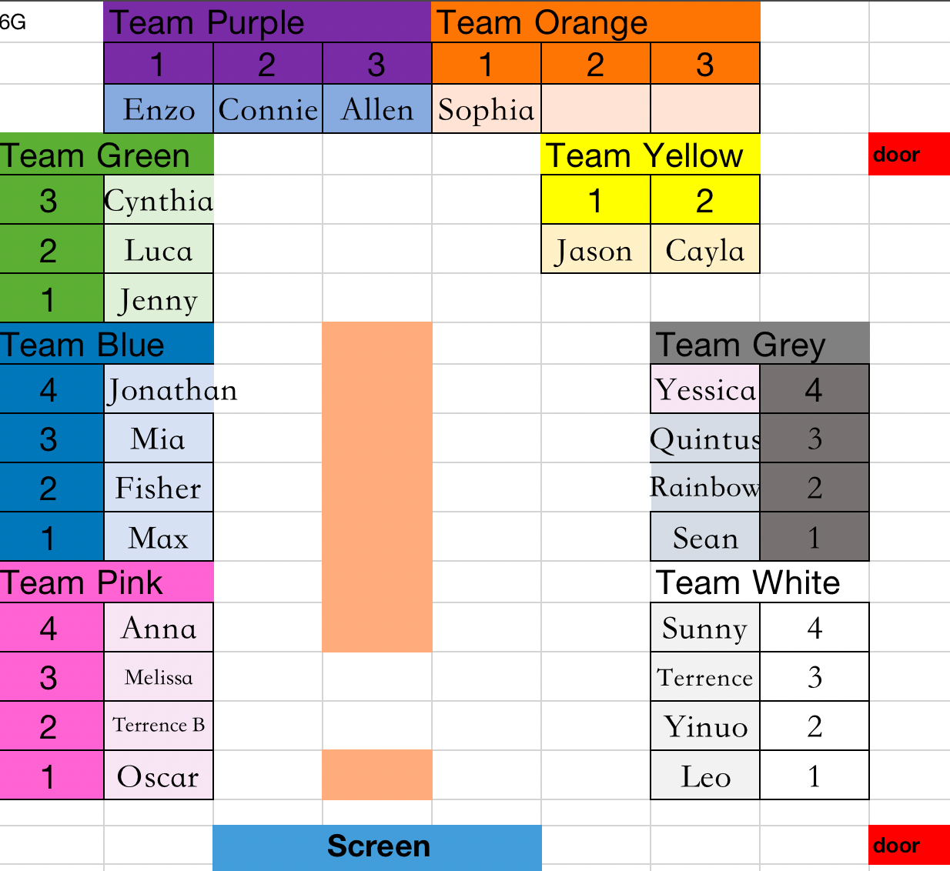

Slide 2
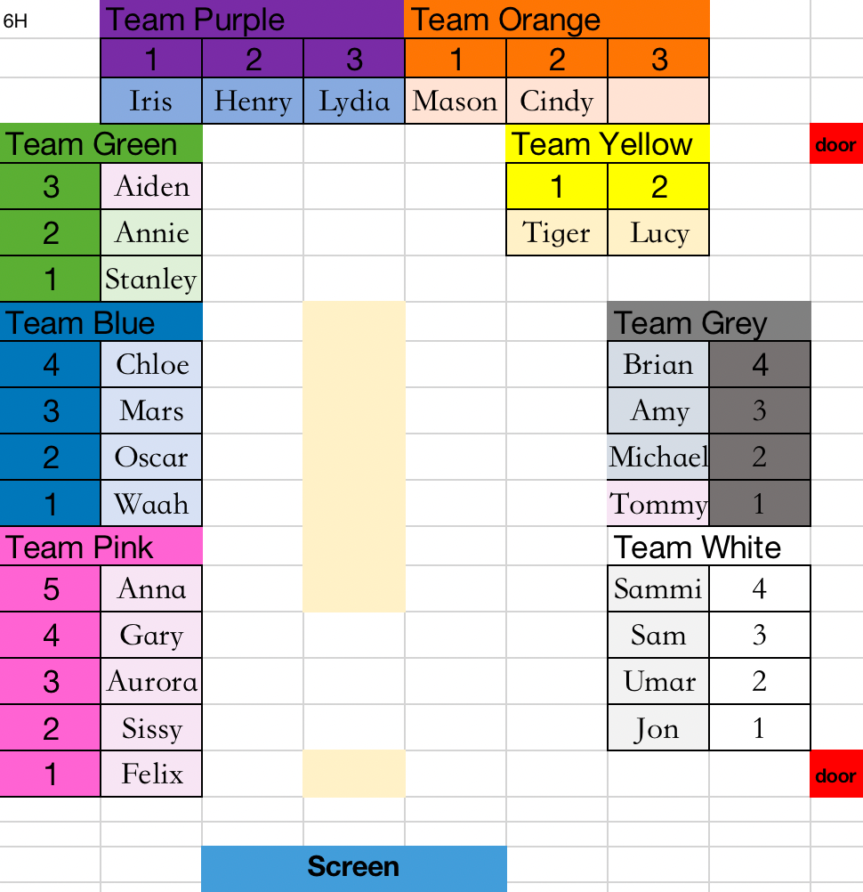

Slide 3
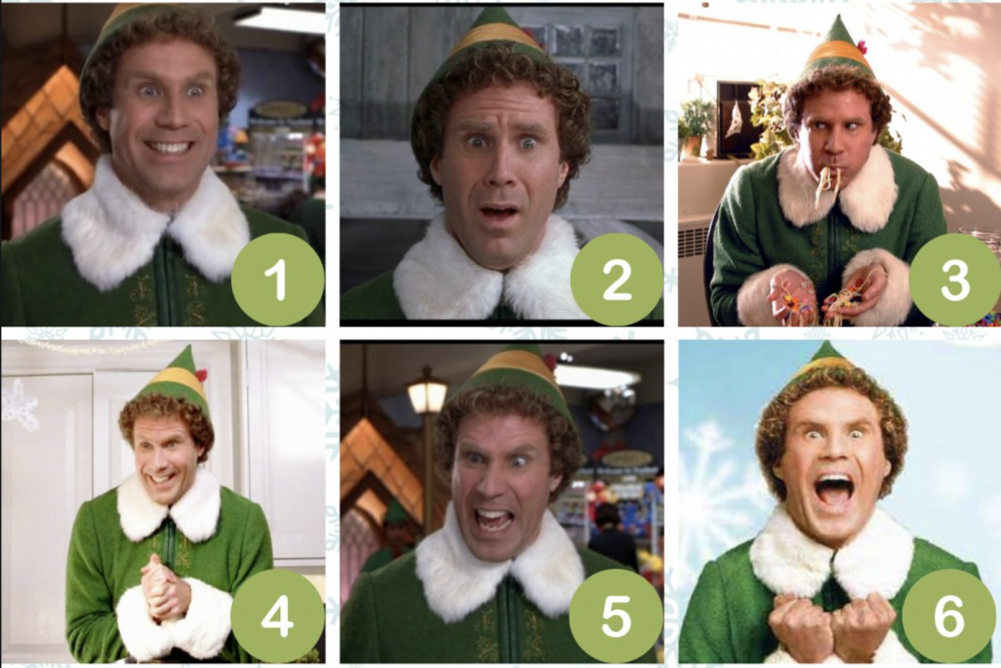
How are you feeling this week?
December 5

Slide 4
True or false?
Software that helps computer function.
System software.

Slide 5


True or false?
Software that helps computer functions is system software.

Slide 6
True or false?
The physical components of a computer system are know as software.

Slide 7


True or false?
The physical components of a computer system are know as software.
Hardware

Slide 8
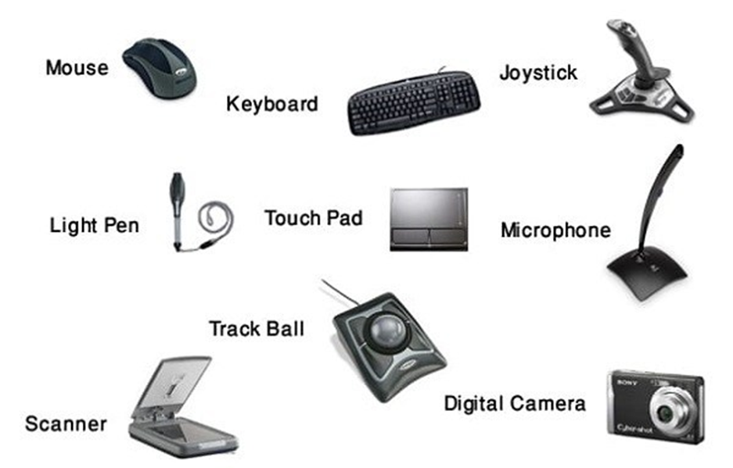
True or false?
Output devices:

Slide 9
True or false?
Output devices:
Input devices
Hardware used to send
data to a computer

Slide 10

Chapter 4.3
Data representation

Slide 11
This week you will:
  Explain that computers use binary to represent all data and instructions
  Explain how binary relates to two-state electrical signals
  Explain the difference between base-2 and base-10 numbers
  Convert between binary and decimal numbers

Slide 12
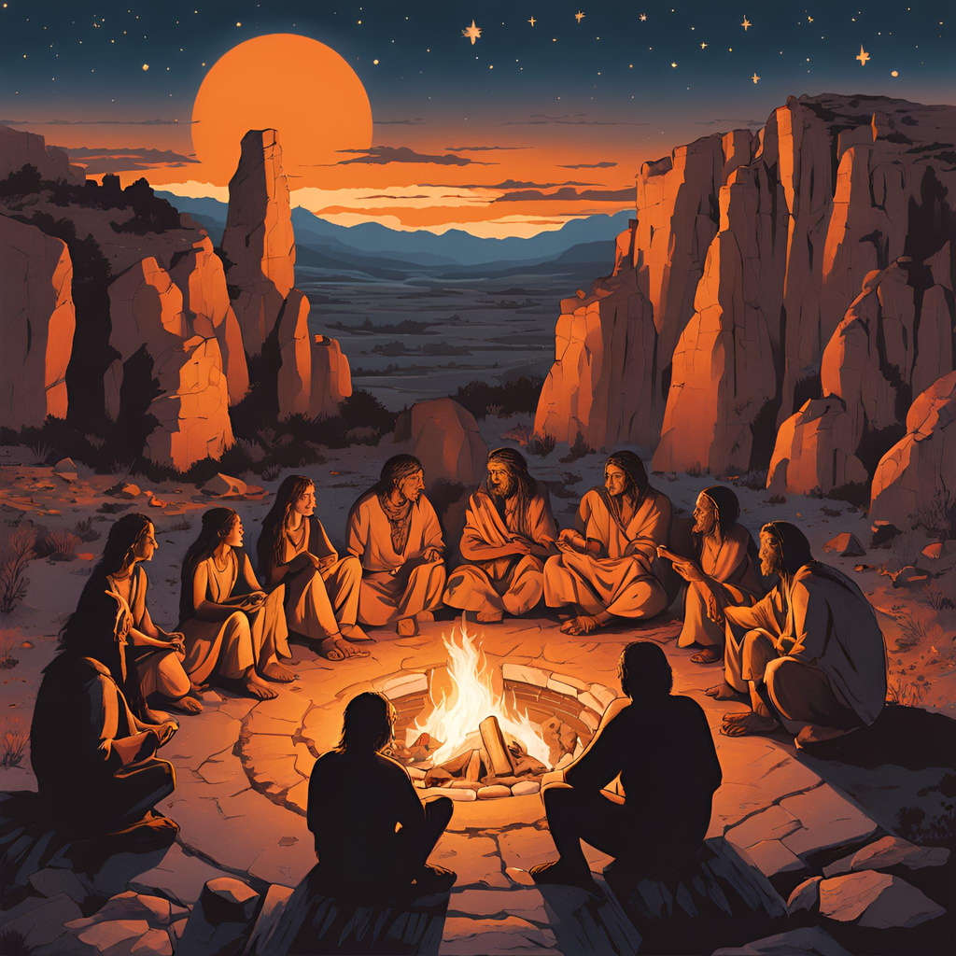
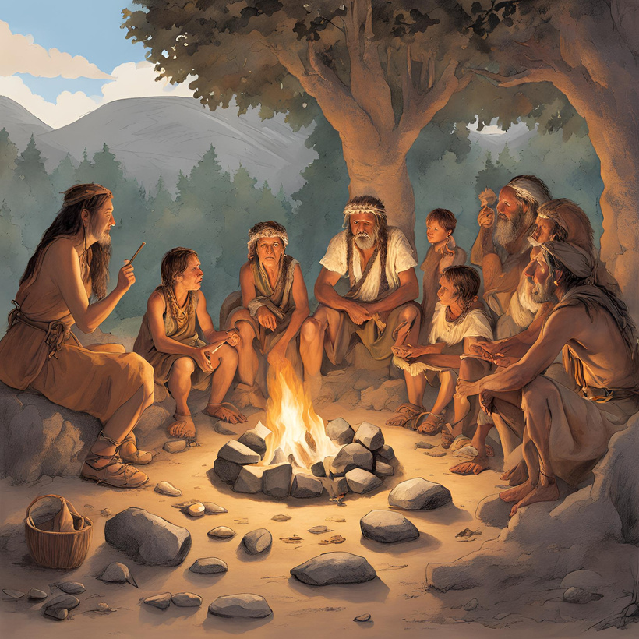
  Why was storytelling important
in early cultures?
2. In what forms did it take?
3. Any limitations?

Slide 13
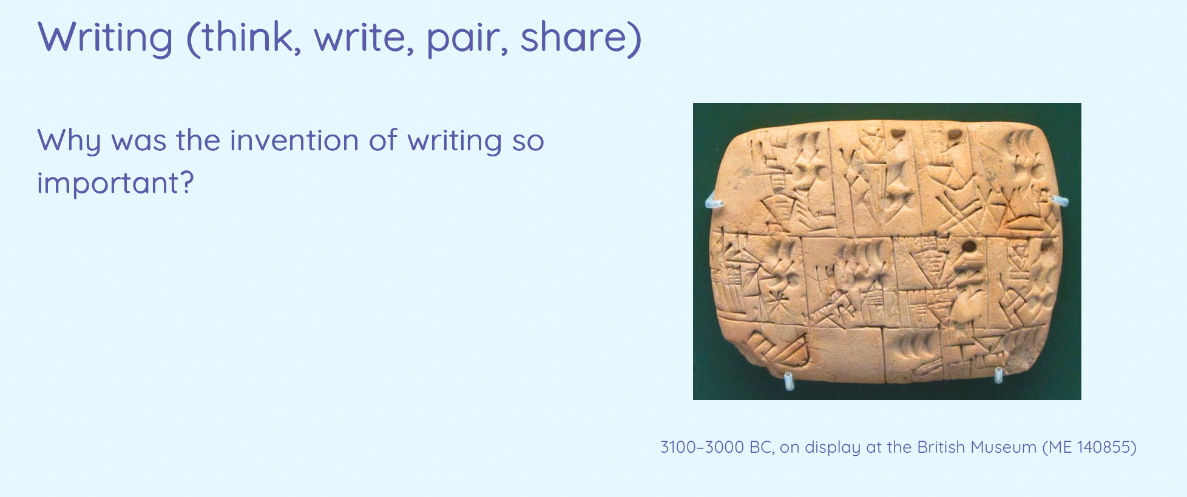
Writing is just a means of representing something.

Slide 14
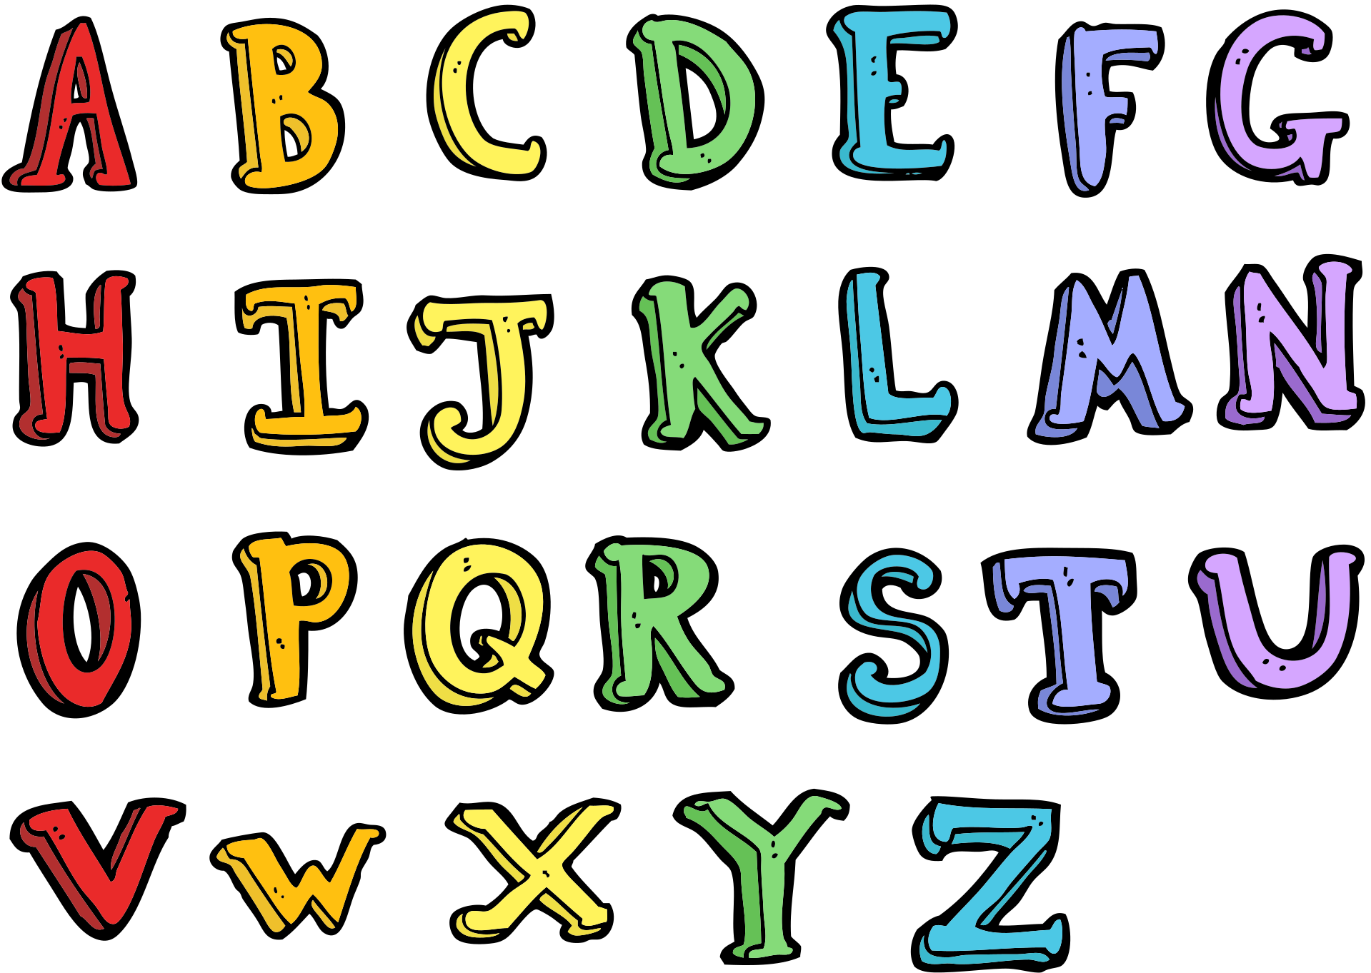
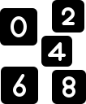
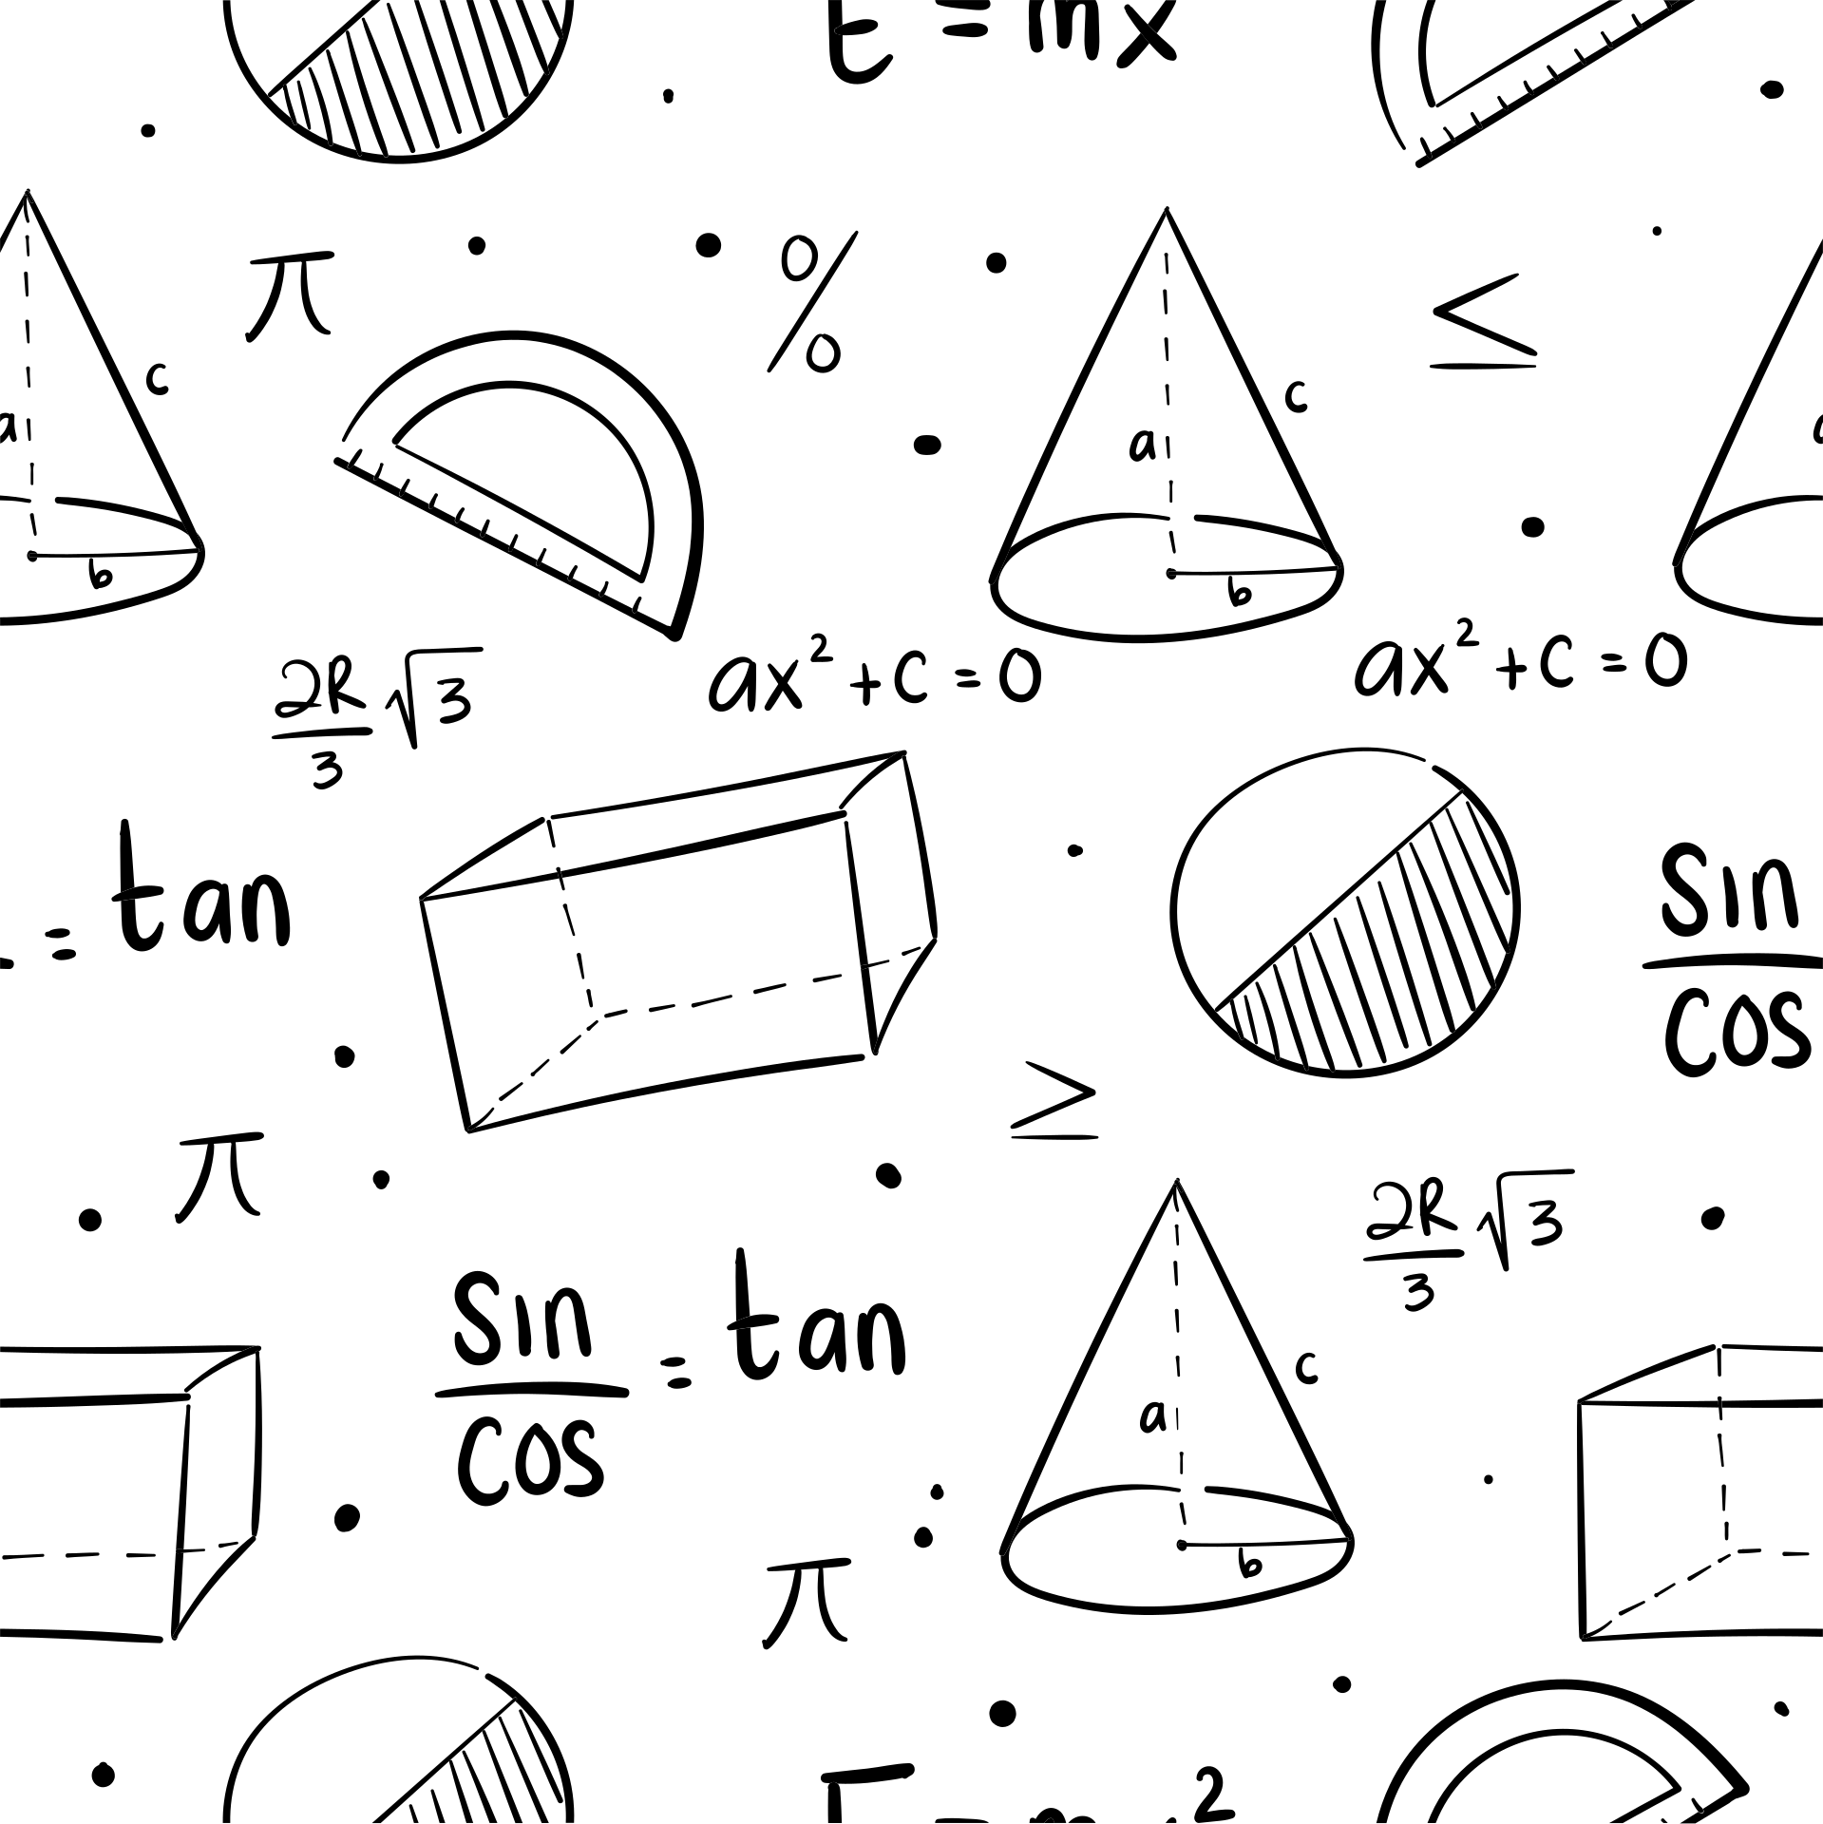

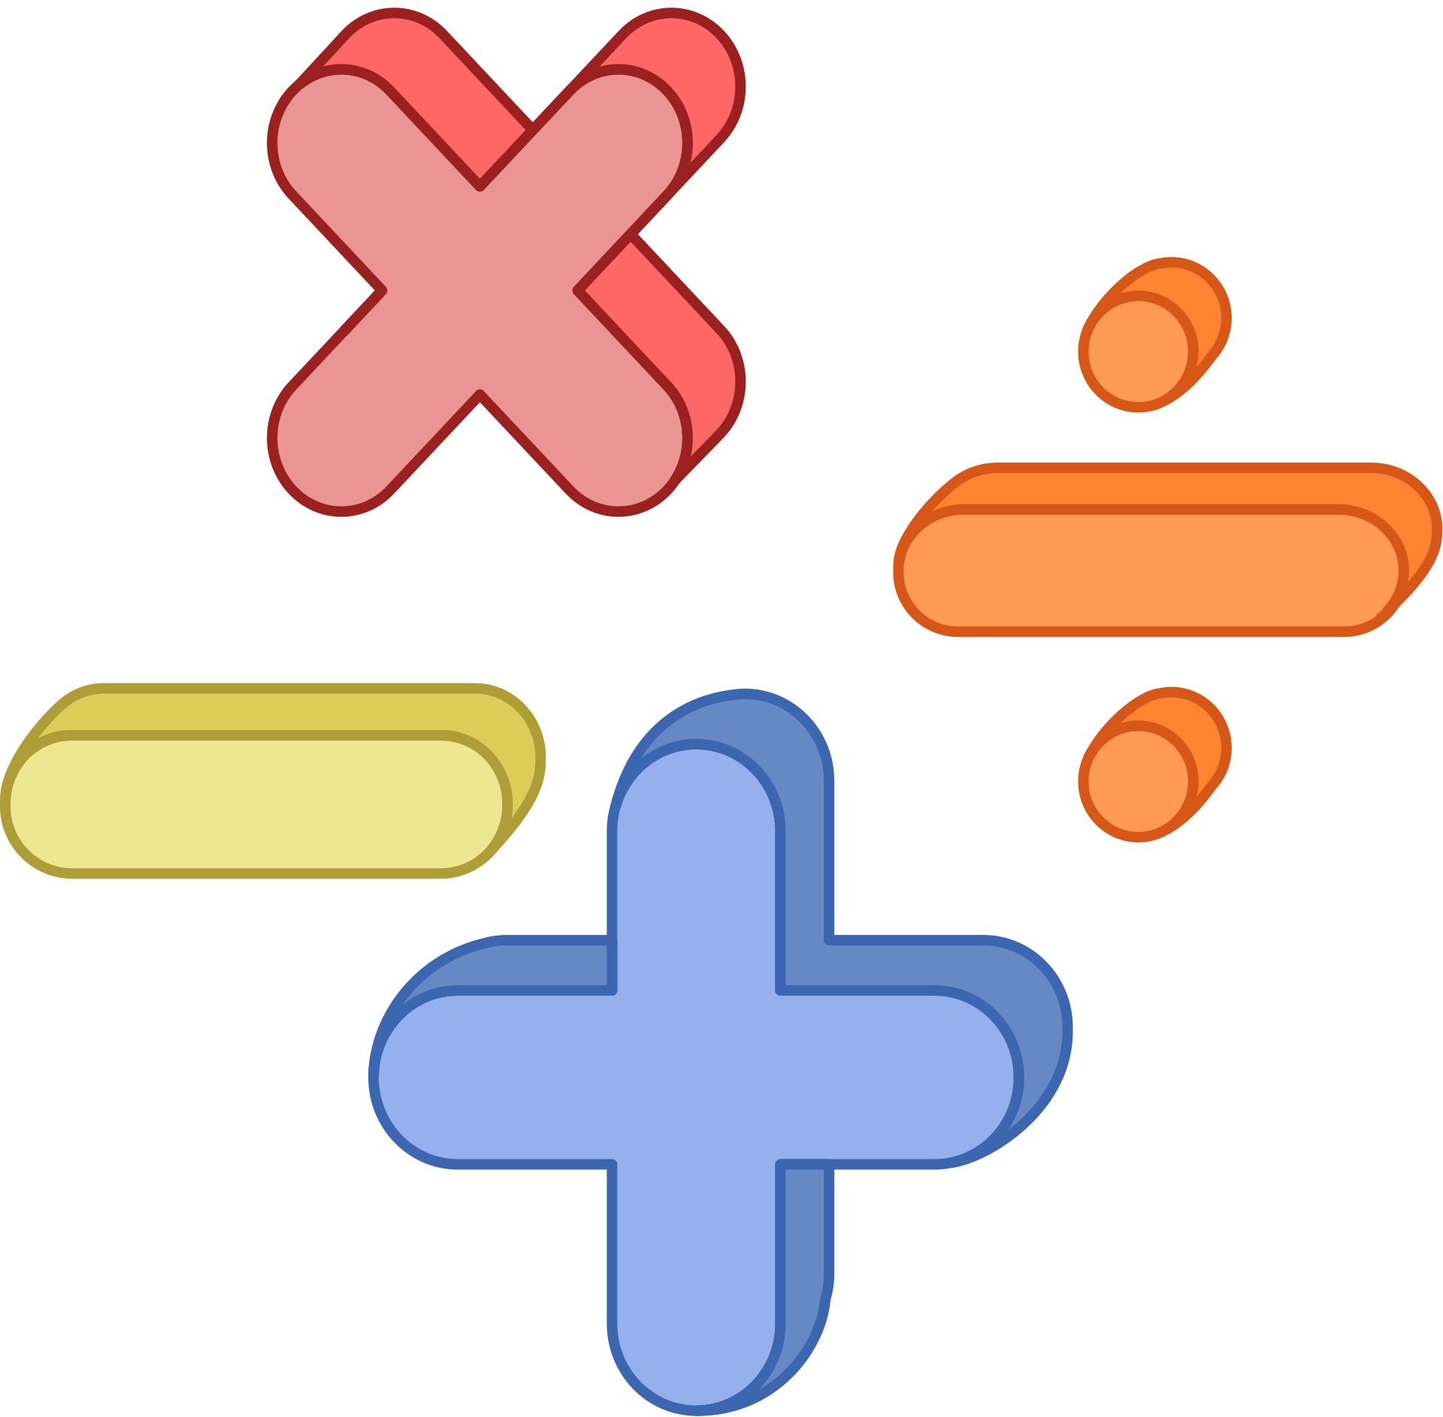


Representation
We use symbols to represent many things.
Can you think of some examples?

Slide 15
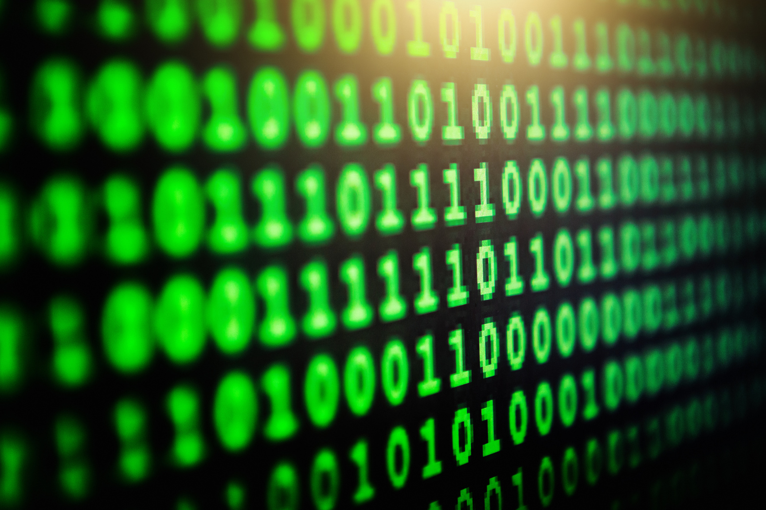
Representation of data in computers:
Numbers
Letters
Images
Videos
=

Slide 16

Why do we use 0 and 1 to represent any number?

Slide 17
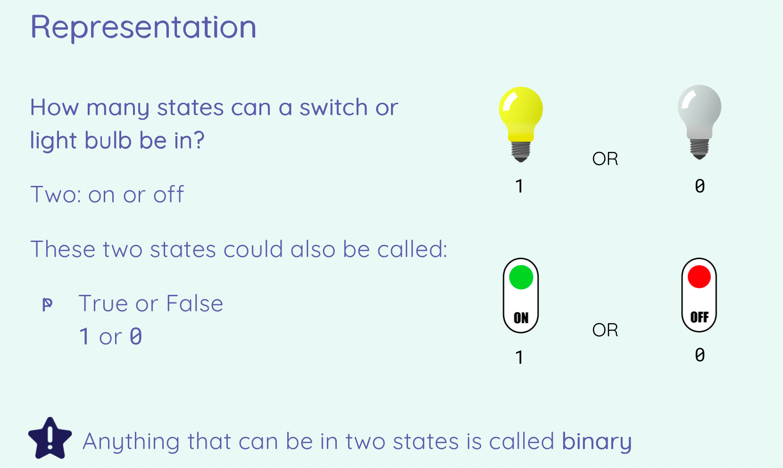

Slide 18
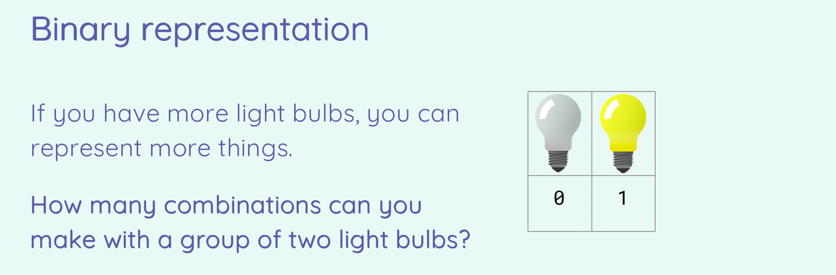
Write down your answer to your notebooks

Slide 19
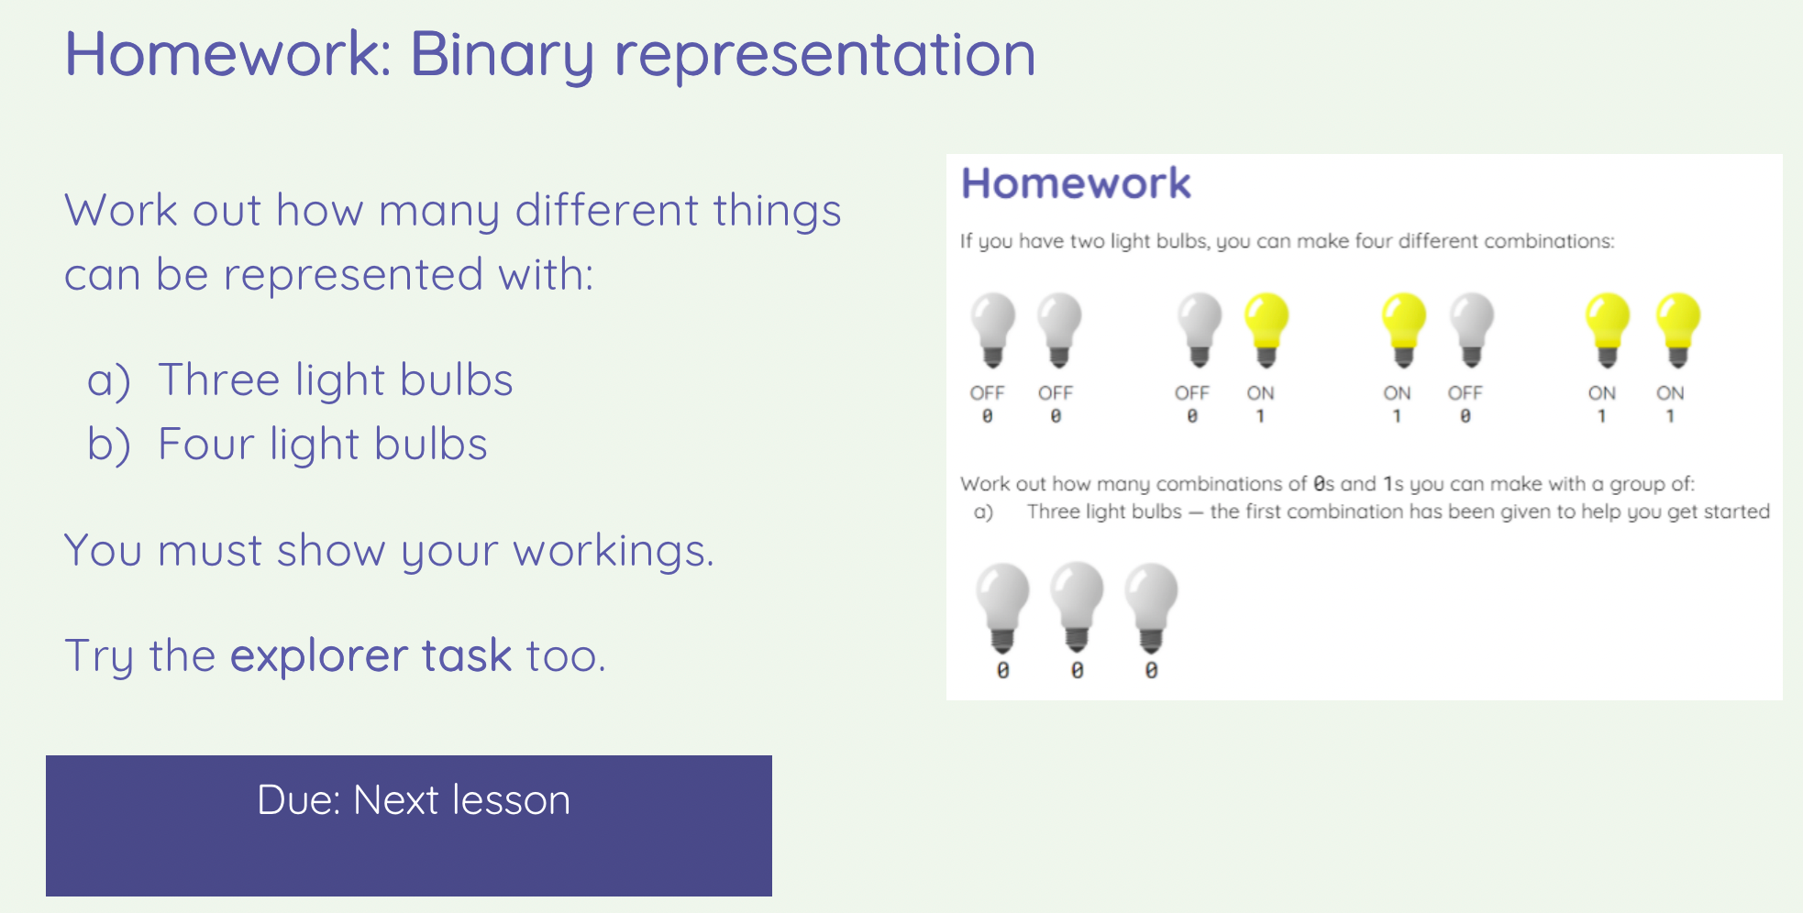

Slide 20
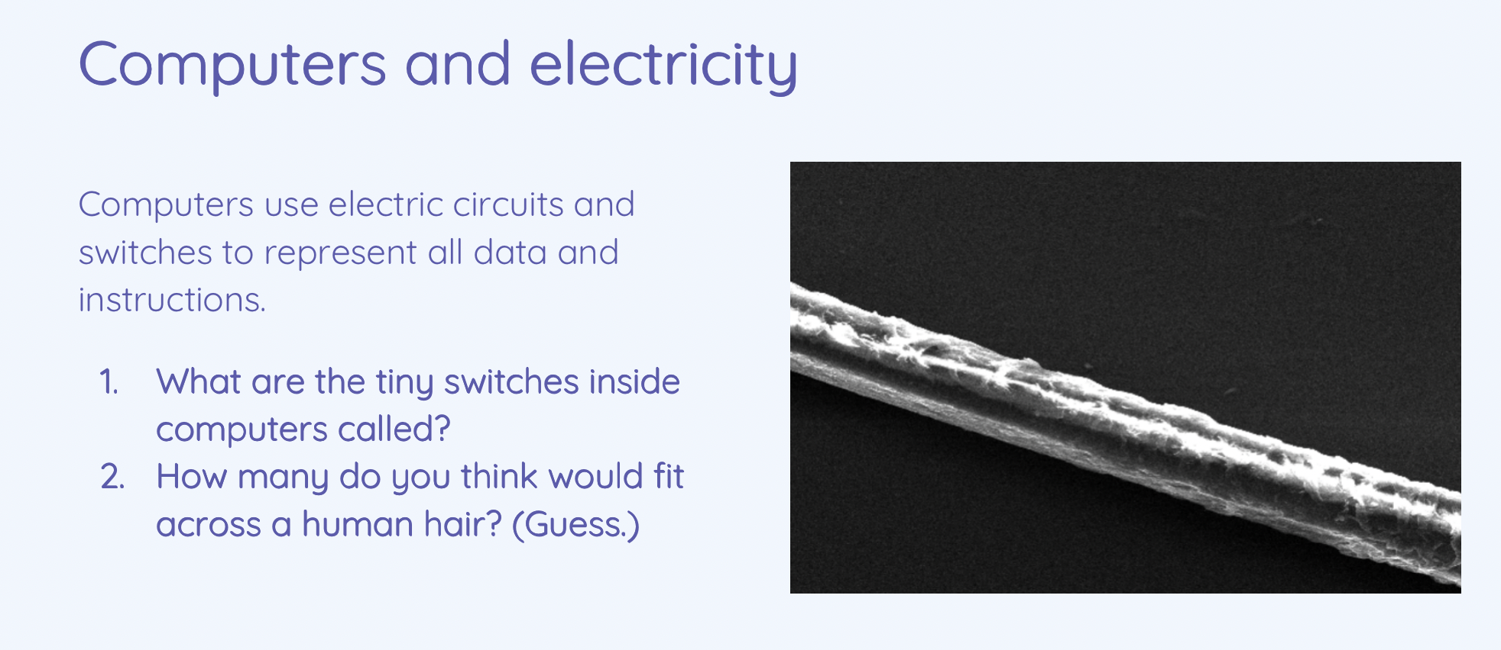

Slide 21
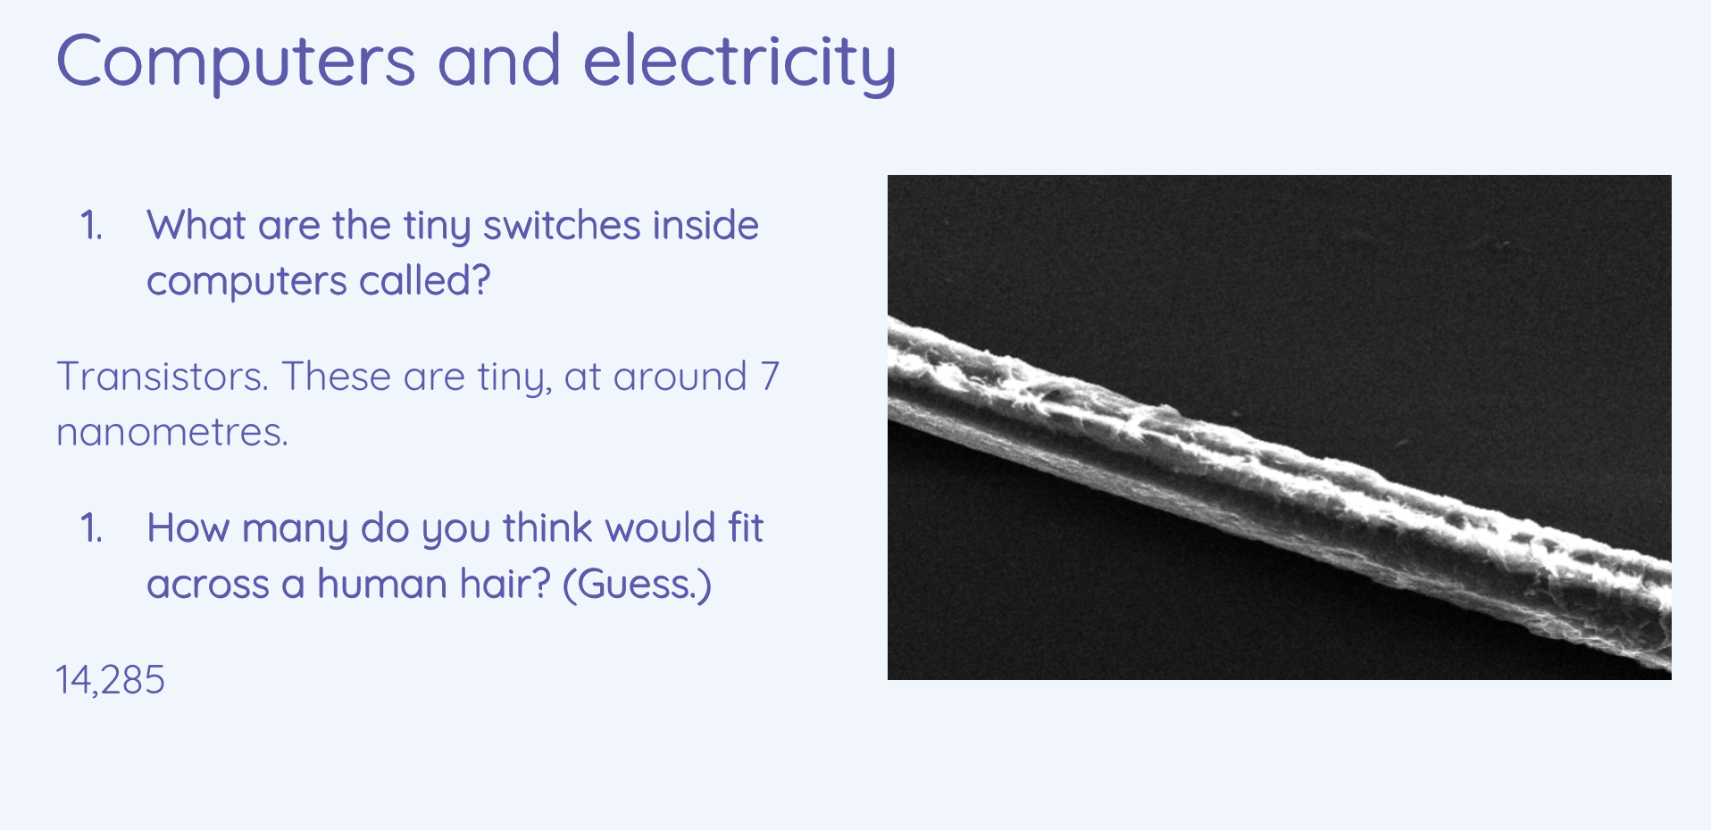

Slide 22
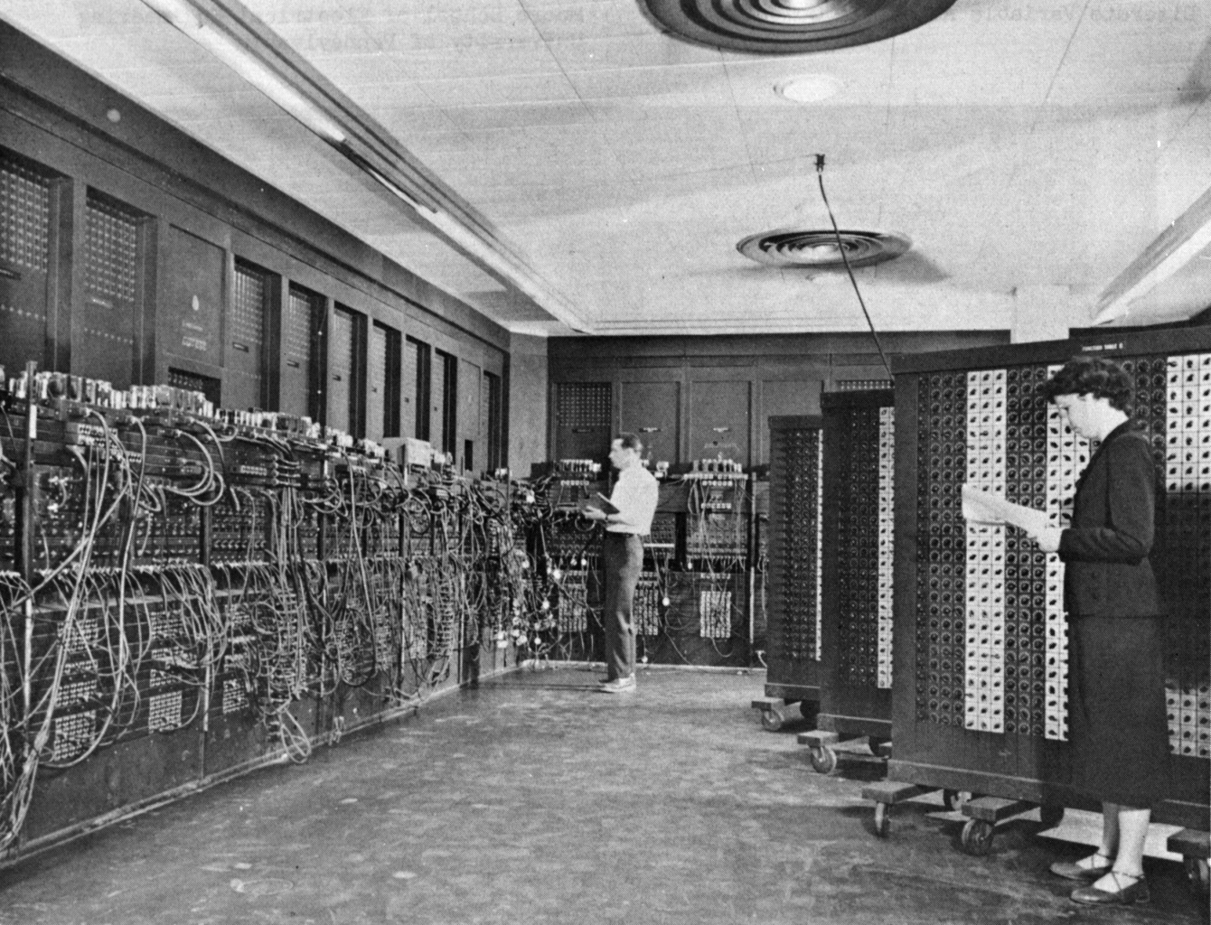
Notes:
The ENIAC[54] (Electronic Numerical Integrator and Computer) was the first electronic programmable computer built in the U.S. Although the ENIAC was similar to the Colossus, it was much faster, more flexible, and it was Turing-complete. Like the Colossus, a "program" on the ENIAC was defined by the states of its patch cables and switches, a far cry from the stored program electronic machines that came later. Once a program was written, it had to be mechanically set into the machine with manual resetting of plugs and switches. The programmers of the ENIAC were six women, often known collectively as the "ENIAC girls"

Slide 23
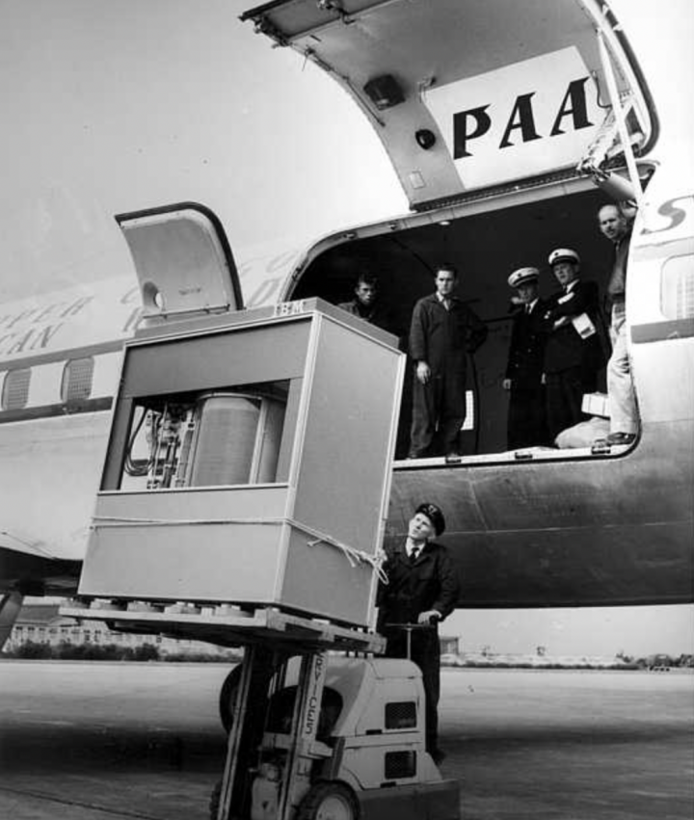
A 5MB hard disk drive from Apple cost $3,500 in 1981. That’s $700,000 per gigabyte.
An IBM hard disk drive unit
5 MB
Was leased for $3,200 per month
Nowadays, we will pay around $18 for 1TB of hard disk space.

Slide 24
  Complete the flashcards
  Complete the quiz and show me the result.
  Complete the worksheet (if not completed - complete at home)

Slide 25
Instructions:
  Review flashcards
  “Gameshow quiz” or “quiz”
  Show me your result
Important terms of chapter 4.1 - 4.3
Click here

Slide 26
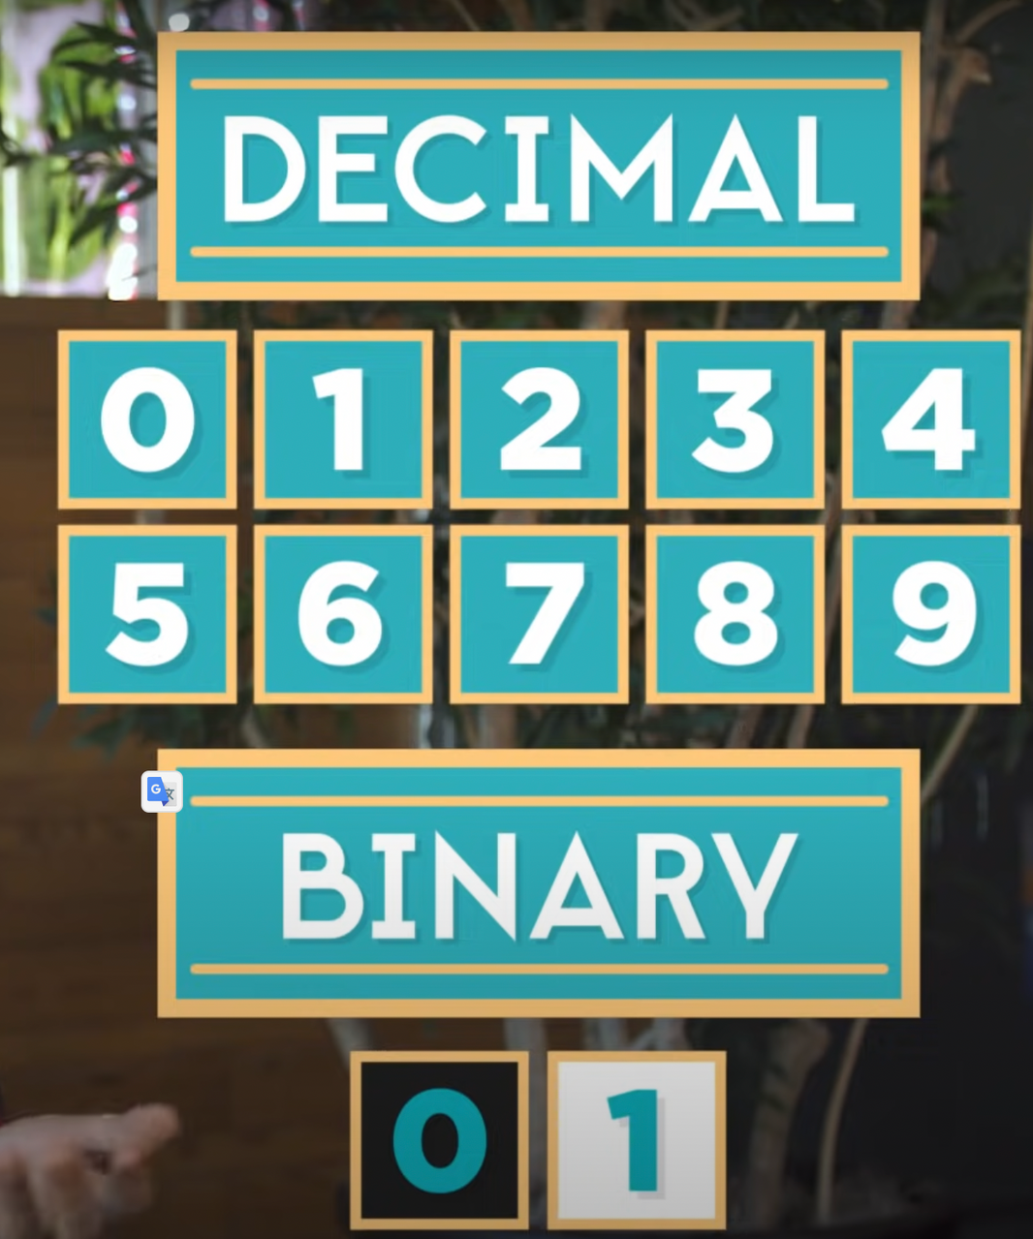

Slide 27
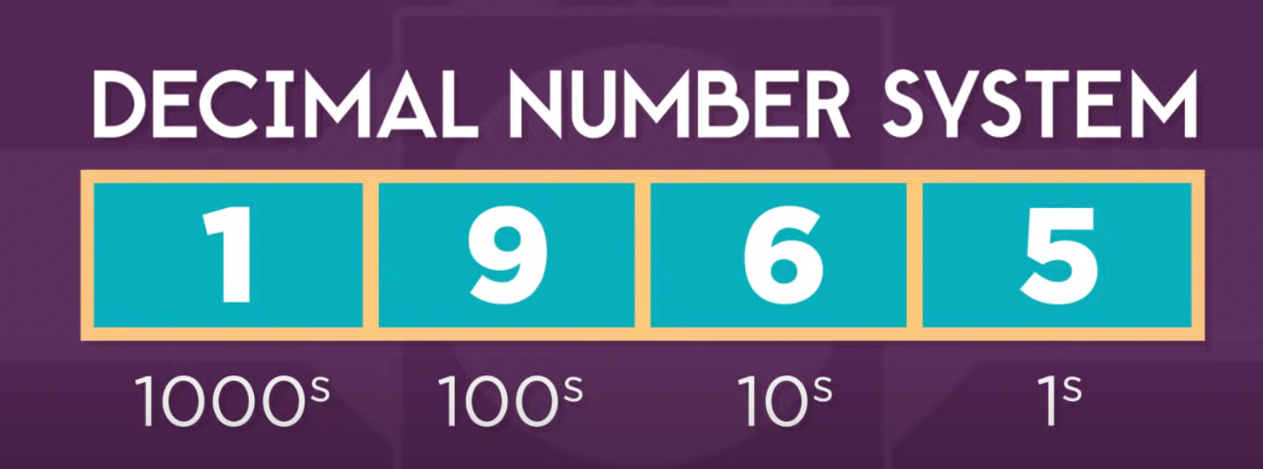

Slide 28
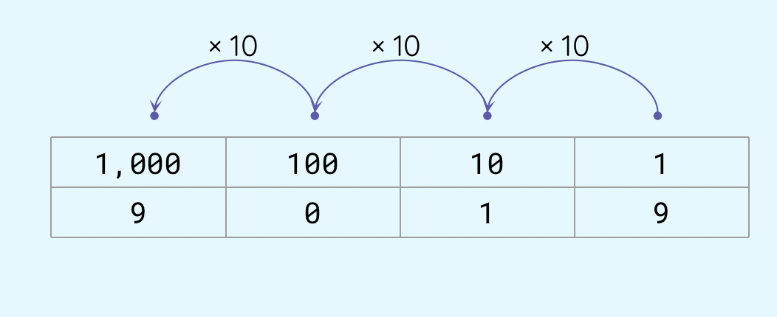

Slide 29
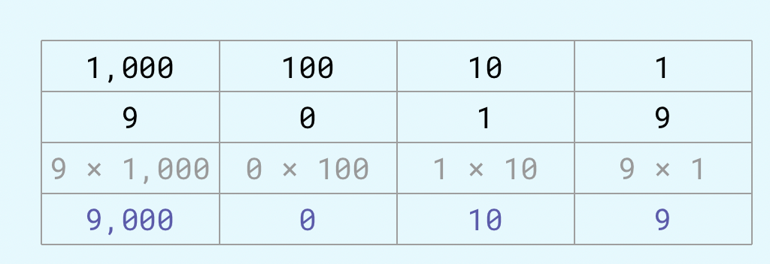

Slide 30
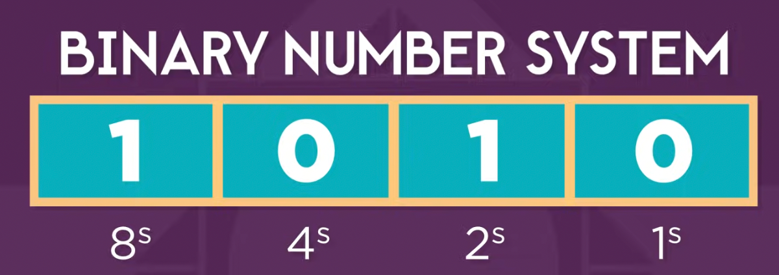

Slide 31
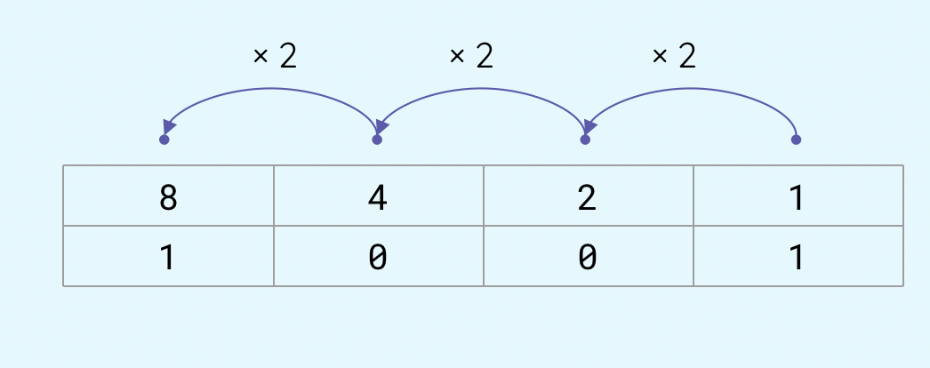

Slide 32
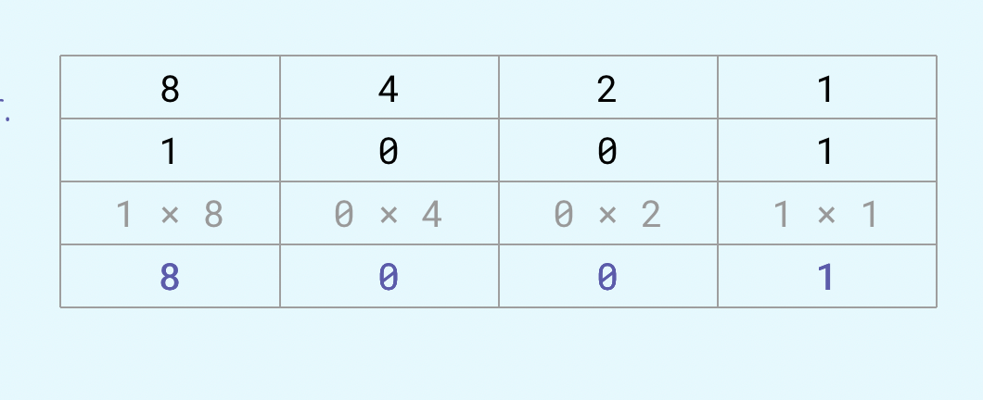

Slide 33
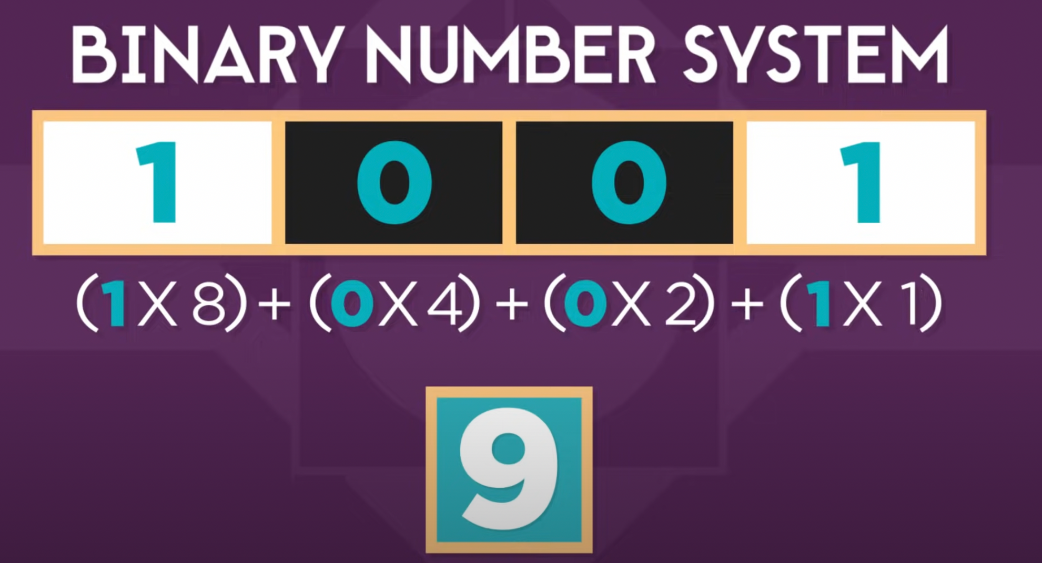
Play binary puzzle: https://learningcontent.cisco.com/games/binary/index.html

Slide 34

Convert binary to decimal

Slide 35
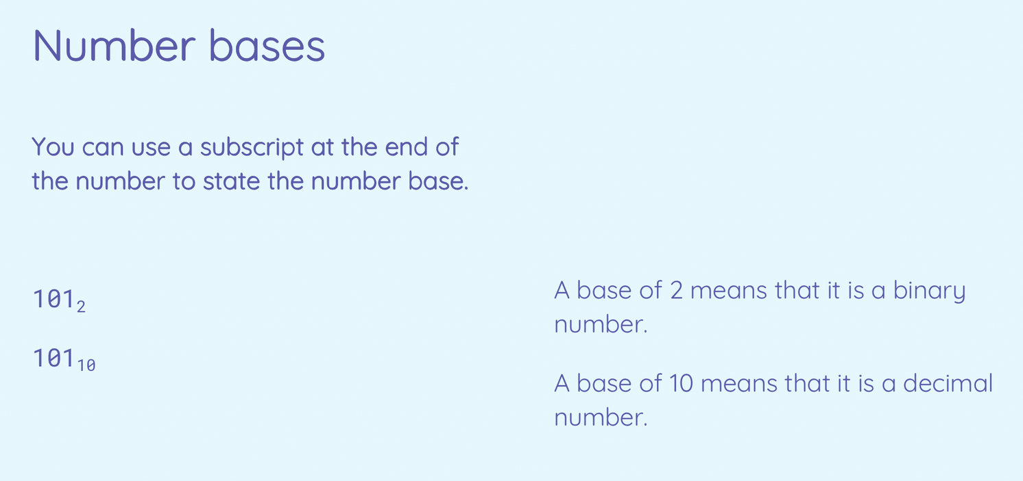

Slide 36
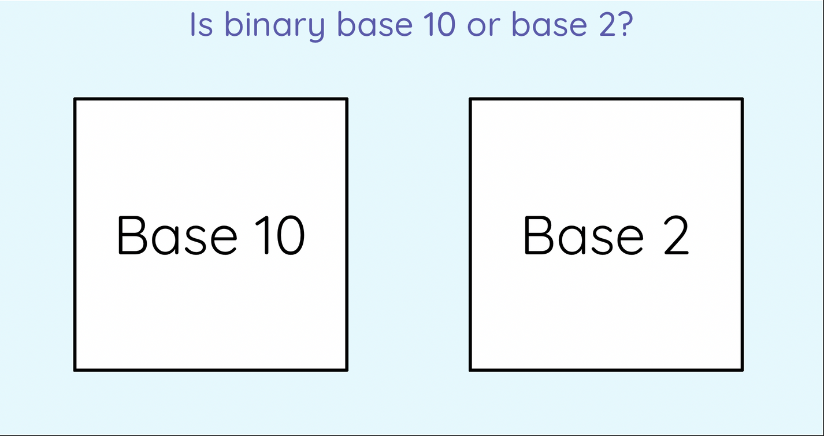

Slide 37
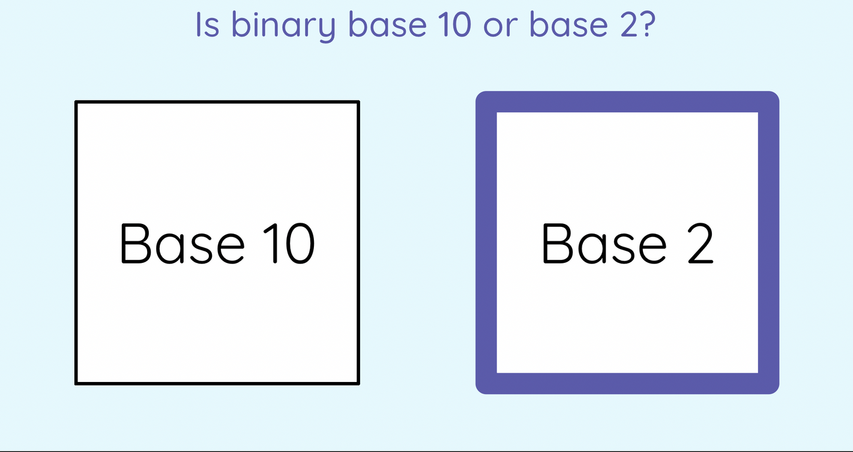

Slide 38
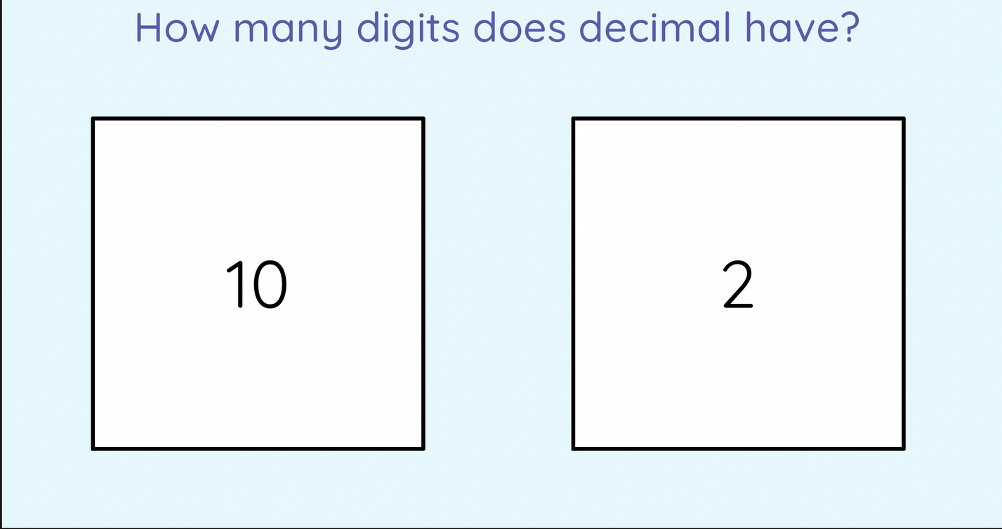

Slide 39
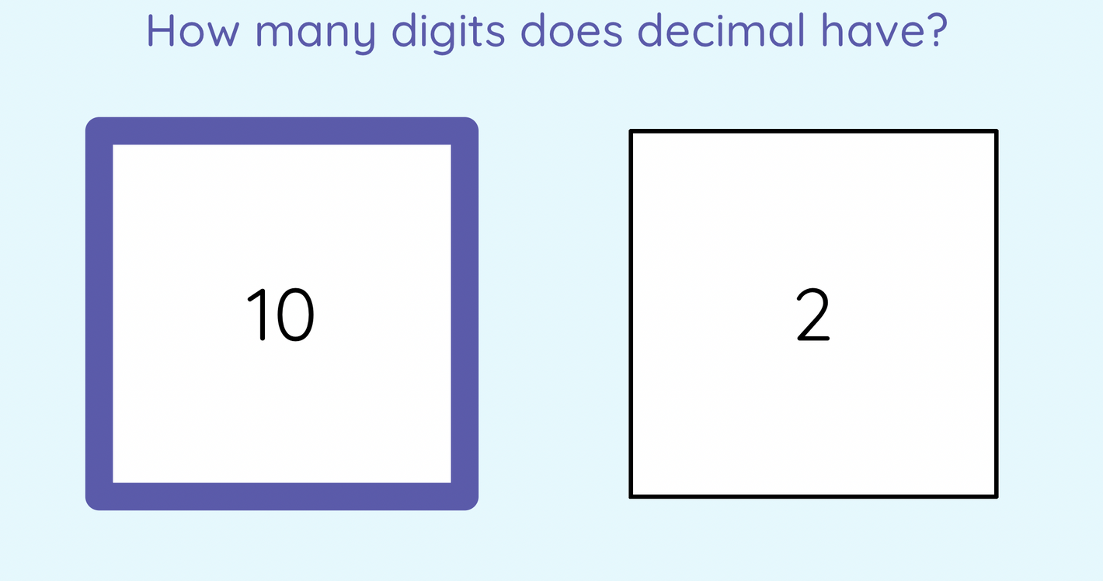

Slide 40
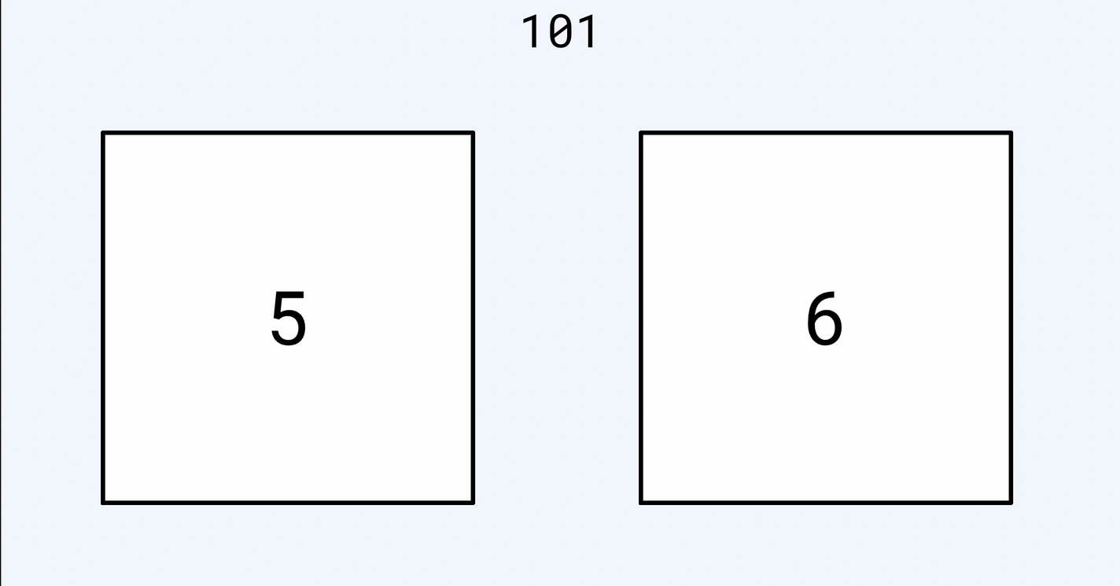

Slide 41
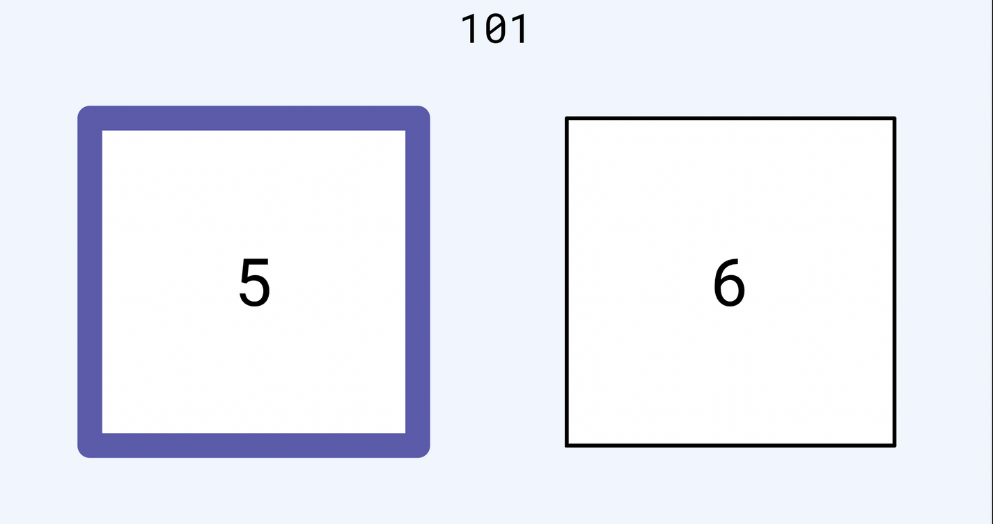

Slide 42
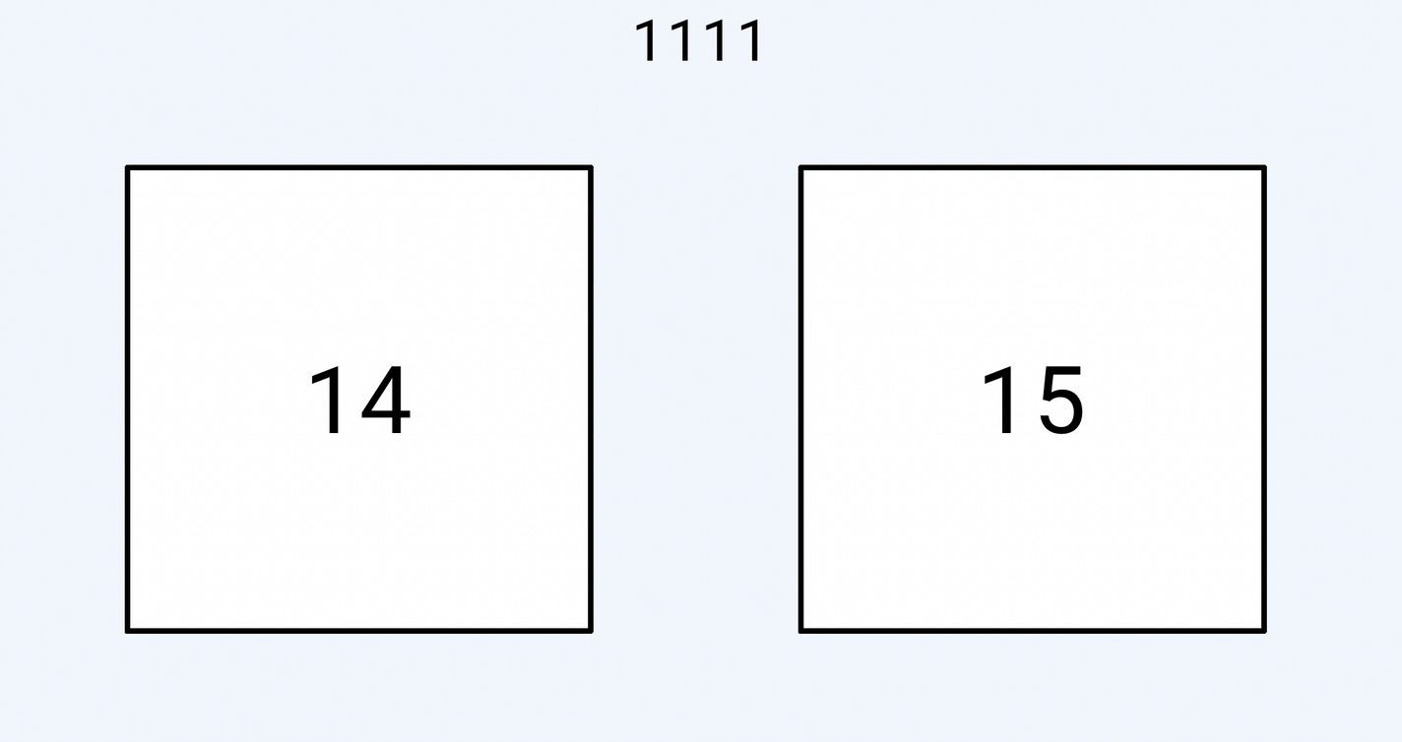

Slide 43
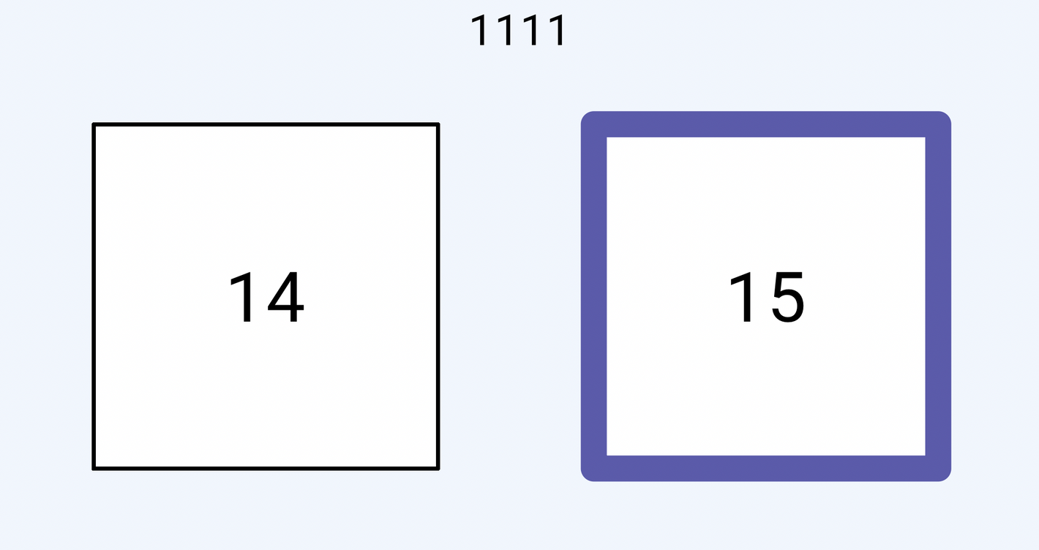

Slide 44
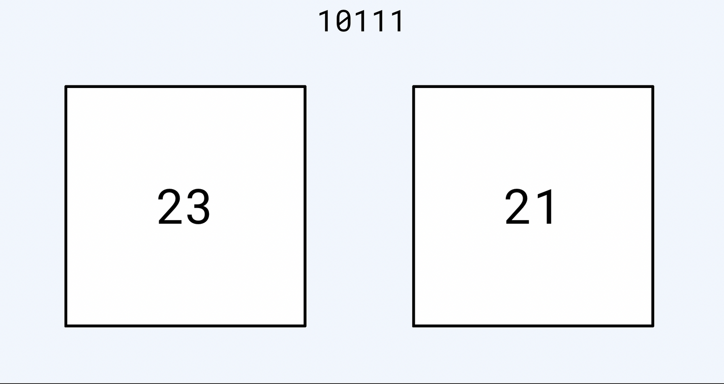

Slide 45
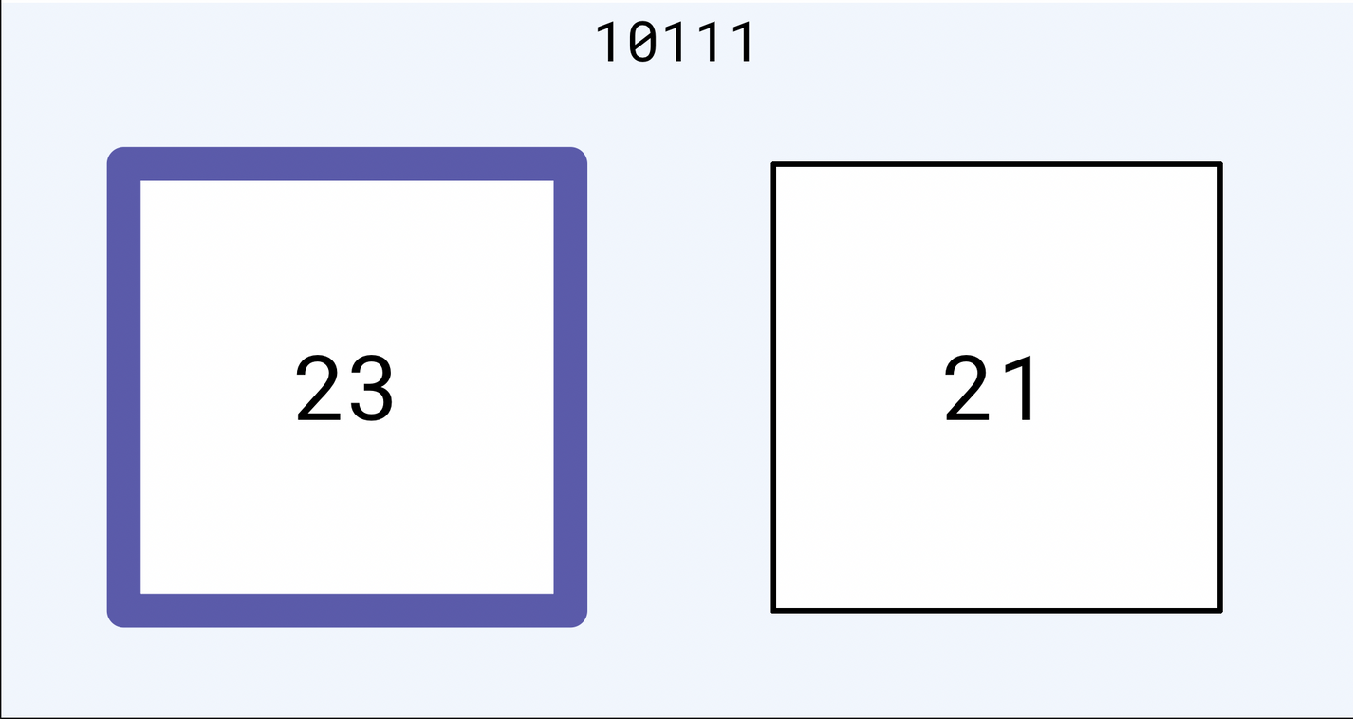

Slide 46
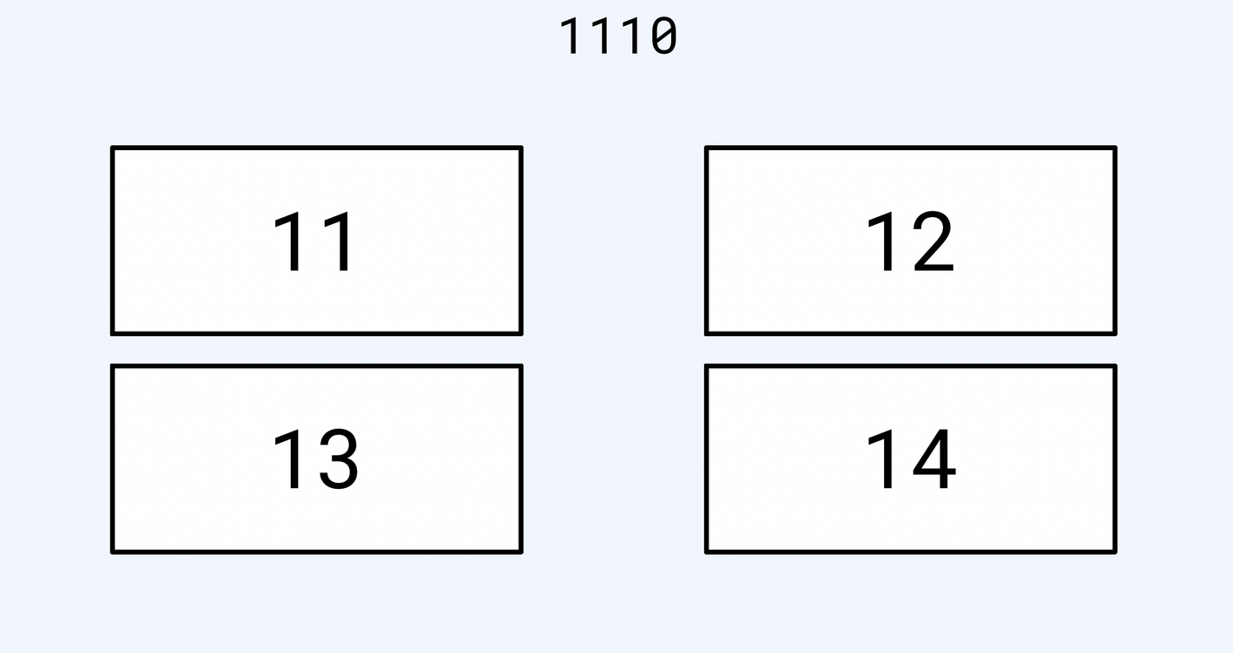

Slide 47
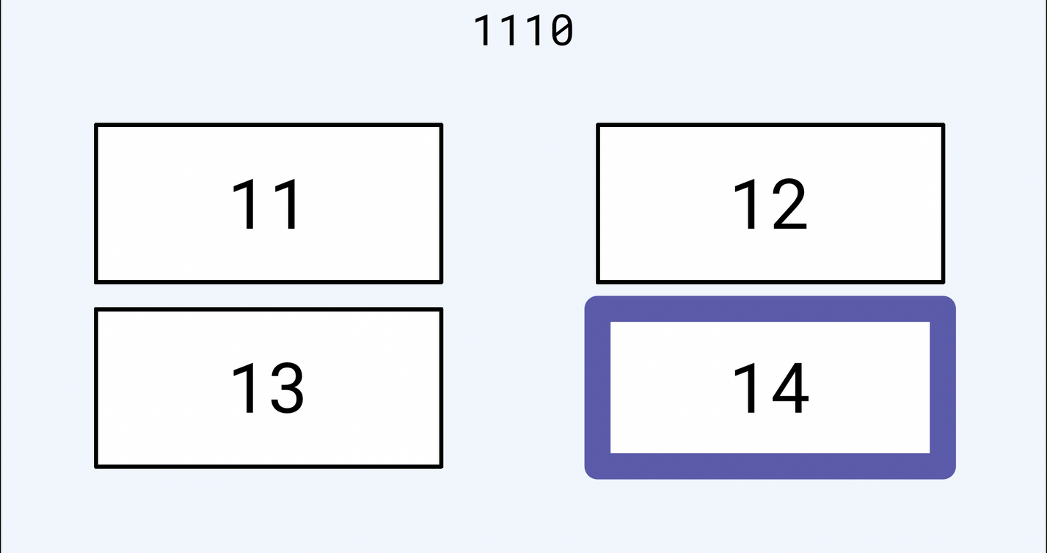

Slide 48
ASCII
a character encoding standard that represents text in computers using numbers.
  7 bits to represent one character or symbol
  128 english language characters and number characters
  Extended ASCII (8 bit) to represent other languages

Slide 49
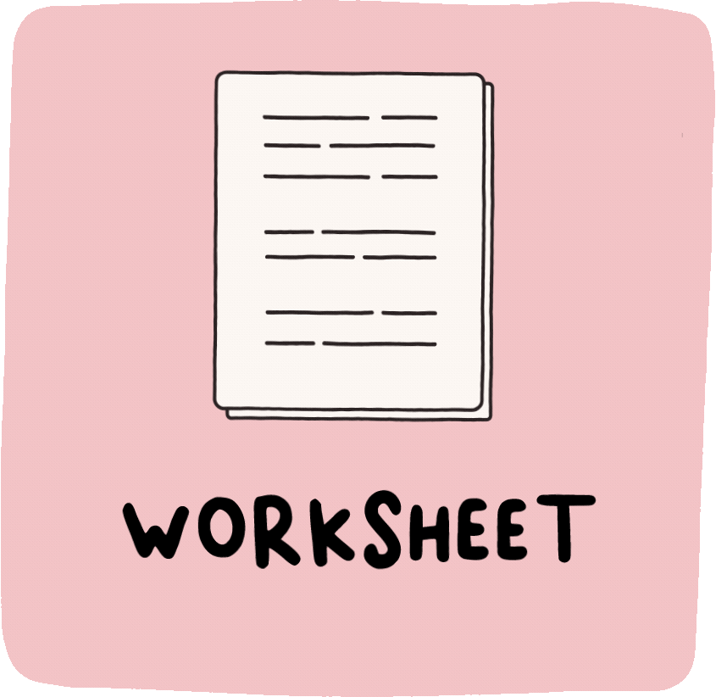
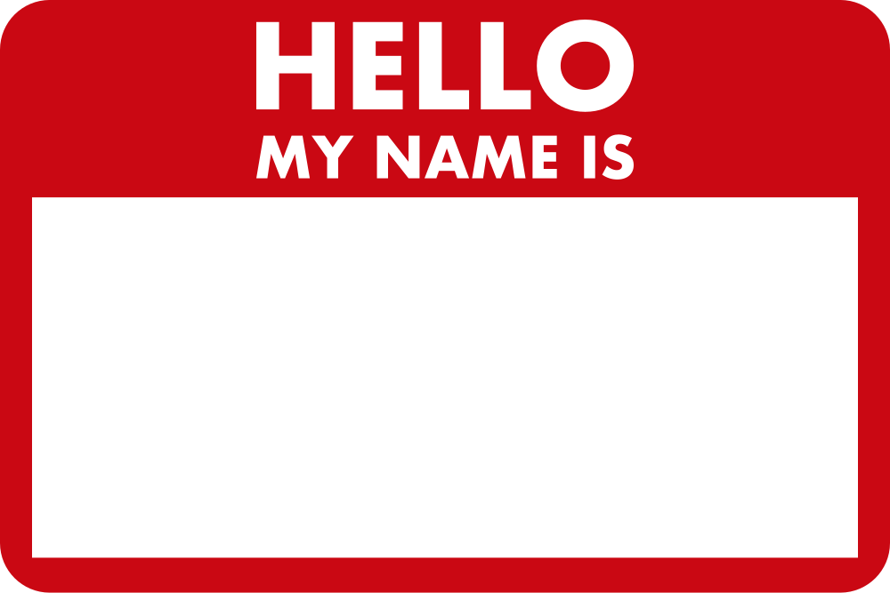
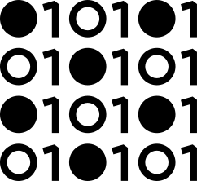
Activity worksheet - code your name!

Slide 50
Binary representation of images

Slide 51
Binary representation of sounds

